Slide 1



Revised Master Plan
Of
Laksam Paurashava
(Proposals)
Presented by
Dr. Mohsin Uddin Ahmed
23.09.2019

Slide 2
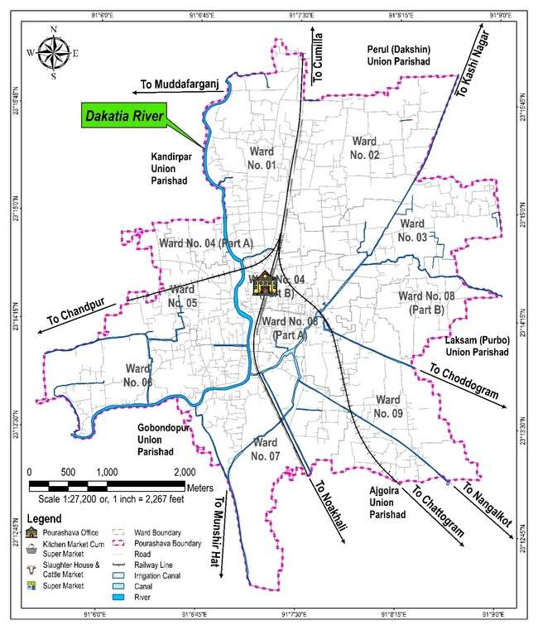
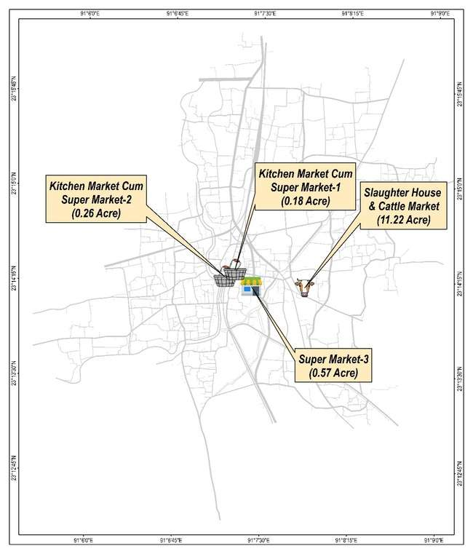
Commercial Zone

Slide 3
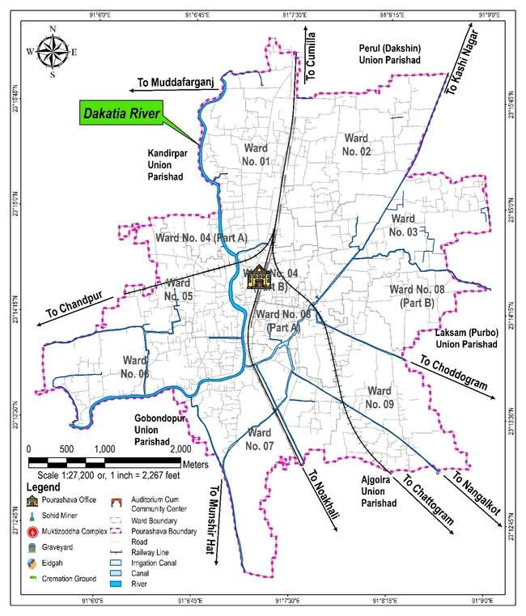
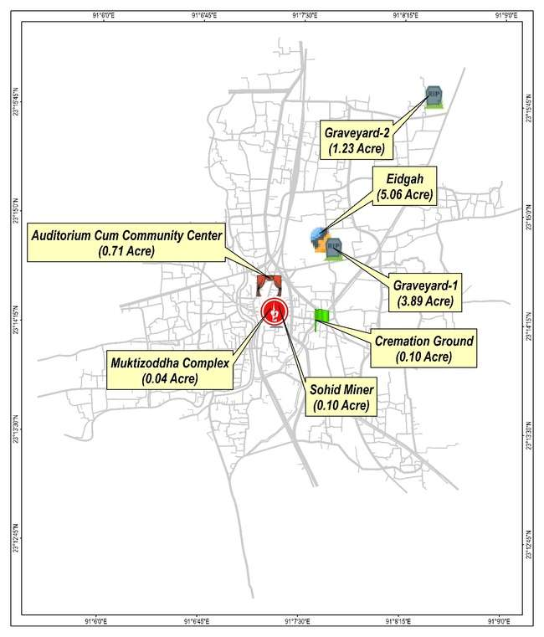
Community Facilities

Slide 4
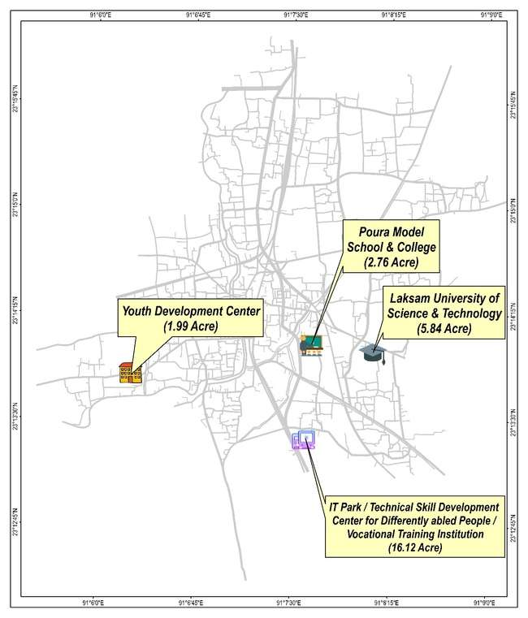
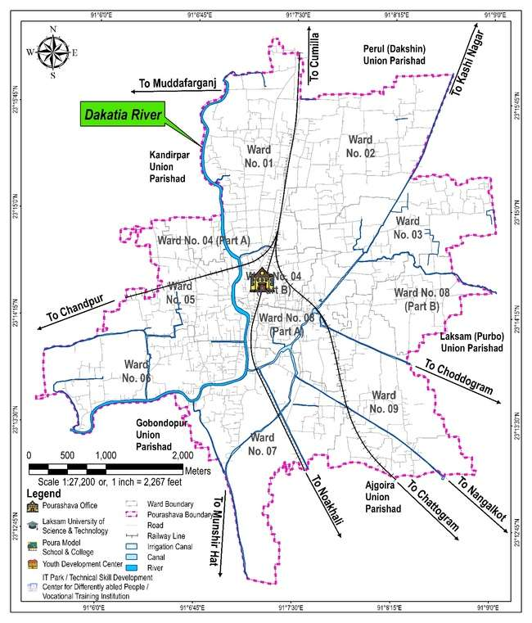
Education & Research
Zone

Slide 5
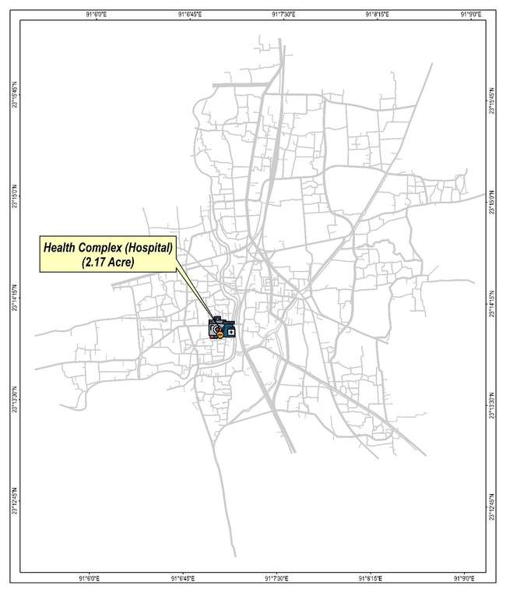
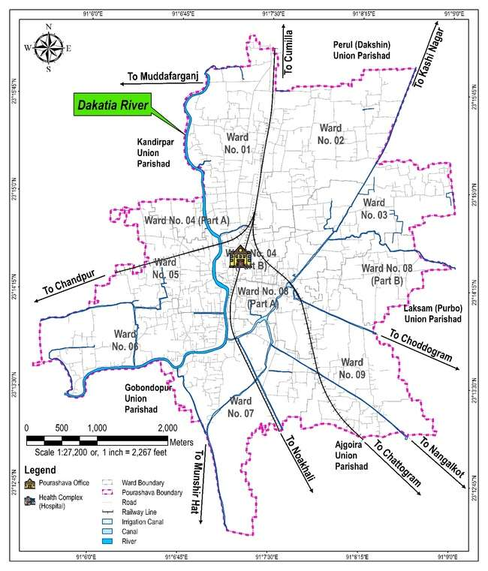
Health Services

Slide 6

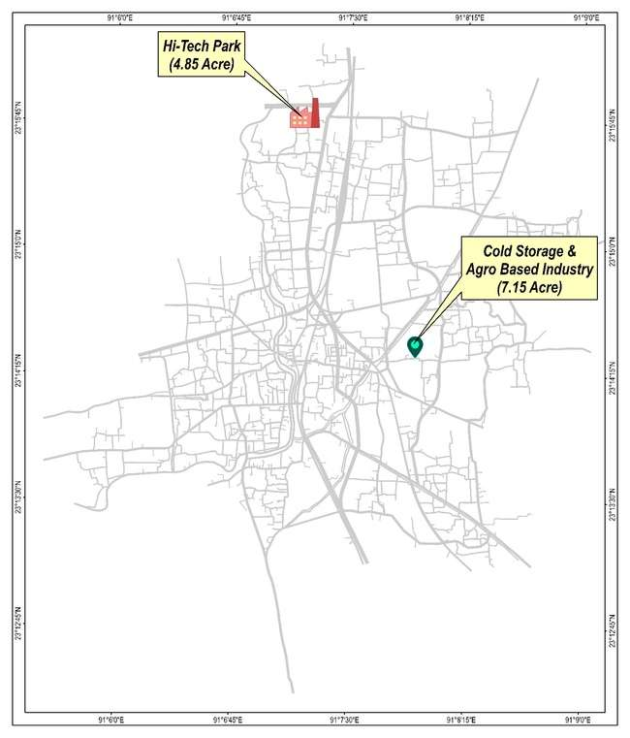
Industrial Zone

Slide 7

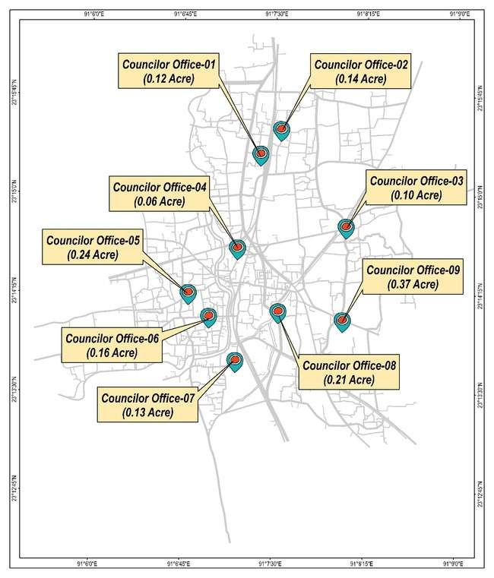
Neighborhood Centre Complex Mixed-Use Building

Slide 8
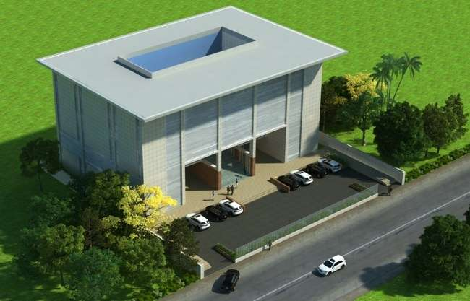

Neighborhood Centre Complex

Slide 9
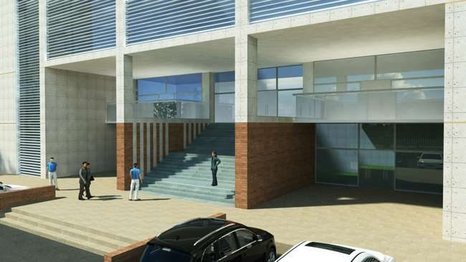
Neighborhood Centre Complex (Entrance of the Building)

Slide 10
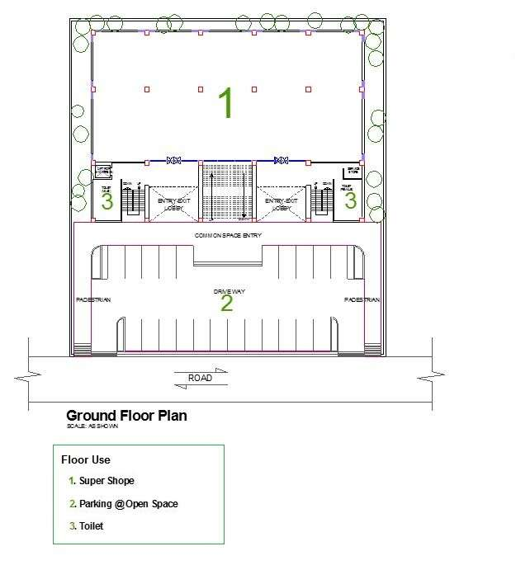
Neighborhood Centre Complex
(Typical Layout for Ground Floor)

Slide 11
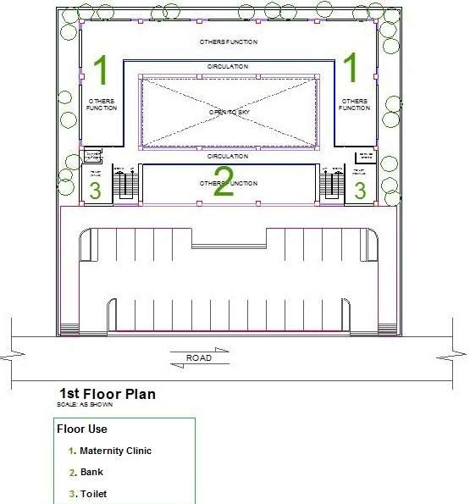
Neighborhood Centre Complex
(Typical Layout for 1st Floor)

Slide 12
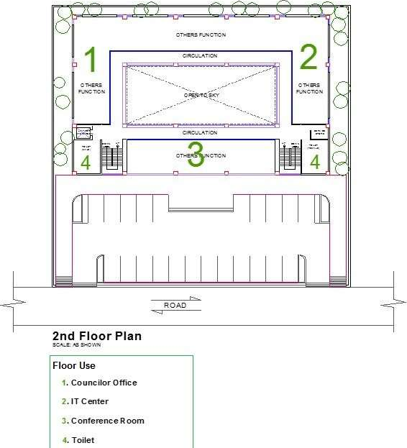
Neighborhood Centre Complex
(Typical Layout for 2nd Floor)

Slide 13
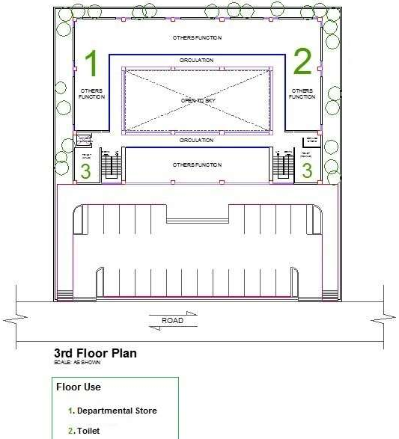
Neighborhood Centre Complex
(Typical Layout for 3rd Floor)

Slide 14
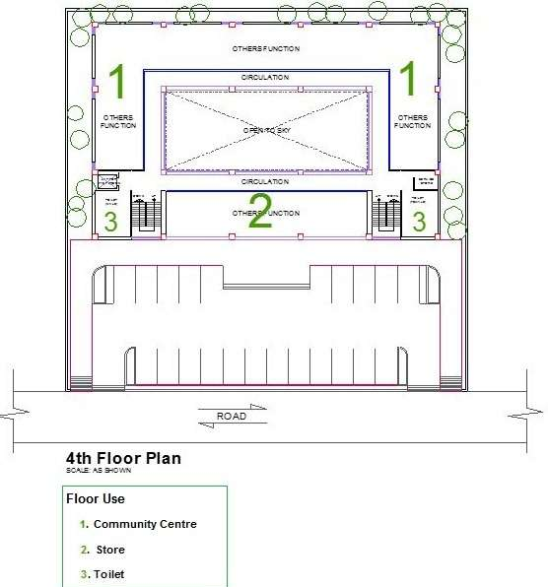
Neighborhood Centre Complex
(Typical Layout for 4th Floor)

Slide 15
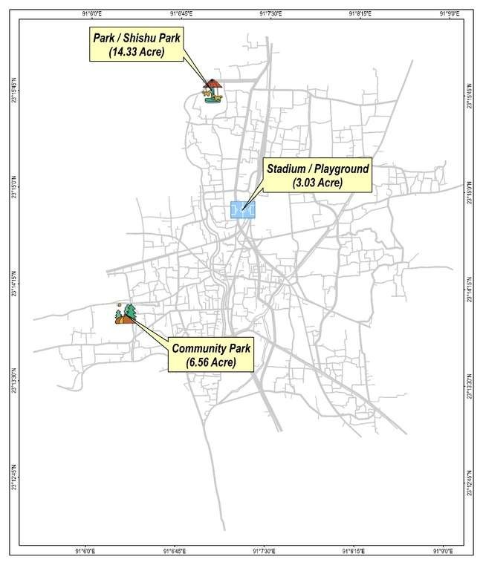
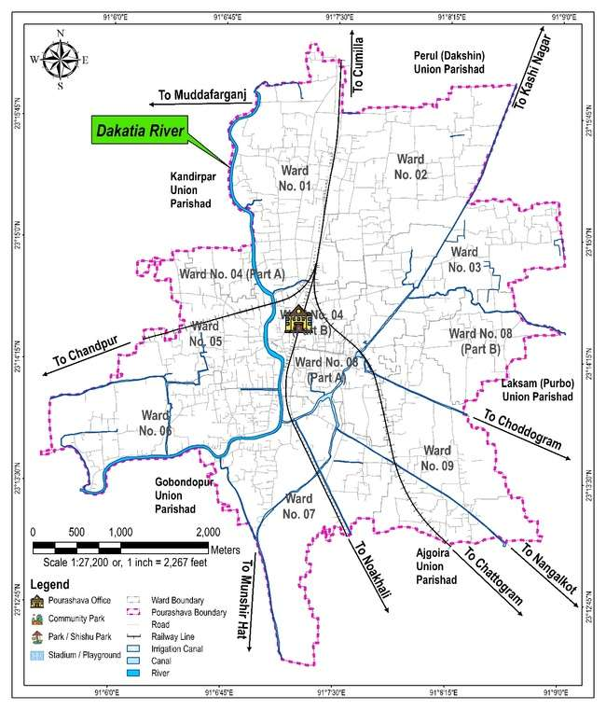
Open Space

